Slide 1

v.0.0.1

Slide 2
Using your Web Browser,
Open this URL:
Click on the workshop you’re attending, and find:
1
http://mlhlocal.host/lhd-resources
2
Setup Instructions
The Code Samples
A demo project
A Workshop FAQ
These Workshop Slides
More Learning Resources
Notes:
What to Say:
Tell attendees we are going to check them in for the event
Once attendees check in, they will receive an email with the items listed on the slide
Attendees must check-in to get credit for attending this event
What to Do:
Confirm that everyone has checked in by asking participants to give you a signal when they receive the email.

Slide 3

Our Mission is to Empower Hackers.
65,000+
HACKERS
12,000+
PROJECTS CREATED
3,000+
SCHOOLS
We hope you learn something awesome today!
Find more resources: http://mlh.io/
Notes:
What to Say:
Major League Hacking (MLH) events are meant to bring hackers together so they can learn, build, and share.
Give participants a brief overview of Major League Hacking (MLH).
Tell participants they can learn more at http://mlh.io/
Example Talking Points:
TODO
Through Localhost MLH is rethinking technology education to reflect how hackers actually learn and how fast the industry moves.
Here’s some quick facts about MLH:
Each year, MLH supports over 65,000 hackers around the world at events they facilitate
Those students create more than 12,000 amazing projects together
MLH is a global organization that empowers hackers in more than 400 cities and growing every day

Slide 4
What will you learn today?
1
How to configure a Twilio phone number
2
How to set up automatic SMS responses with TwiML
3
How to create a Twilio App!
Notes:
What to Say:
Explain to participants what they will learn today
Learning is a core part of being a hacker and today they are going to learn something new
What to Do:
Get participants excited about the experience.

Slide 6

Who has heard of Twilio?

Slide 7
What does Twilio do?
It’s a cloud communication Platform as a Service (PaaS). Twilio can automate sending and receiving:
SMS (texts)
Phone calls
Video
… And more!
Key Term
Platform as a Service (PaaS): A platform for developers to build internet applications without having to build and maintain the underlying infrastructure (e.g. servers) themselves.

Slide 9

What are we going to build with Twilio?
We're going to build an MLH Memes App with these tools:
NodeJS
Glitch
The Twilio SMS API

Slide 10

Cool, let’s try the app!
Text any word to this number:
What happens?
+1 (312) 967 9068
Notes:
Speaker moves to twilio.com/console

Slide 11

Woah, what happened?
It kind of feels like magic, right?
You text a number, and you get back a meme or a gif?
Well, SOME of it's magic. Let's learn how it works.
Notes:
Speaker moves to twilio.com/console

Slide 12
How does it work?
User sends a text to Twilio number
Twilio receives the text and sends it to your app
Our app selects a random image URL from a hard coded list
Our app compiles a Twilio message containing the URL and sends it to the user.
Let’s see how it looks graphically!
Notes:
Speaker moves to twilio.com/console

Slide 13




1
User sends SMS to a Twilio number
Your Twilio Account
Twilio sends the SMS to the Glitch app running from our device
2
Twilio sends the SMS reply back to user!
4
Our app analyses the text and writes a response
3
Notes:
Speaker moves to twilio.com/console

Slide 14

Getting Set Up
We're going to use a few services to make developing this app SUPER easy:
Twilio
Twilio allows us to create SMS and Voice apps. You send a text and it starts running an app behind the scenes.
Glitch
Glitch lets you code right in the browser and deploy it instantly!
Notes:
Speaker moves to twilio.com/console

Slide 15
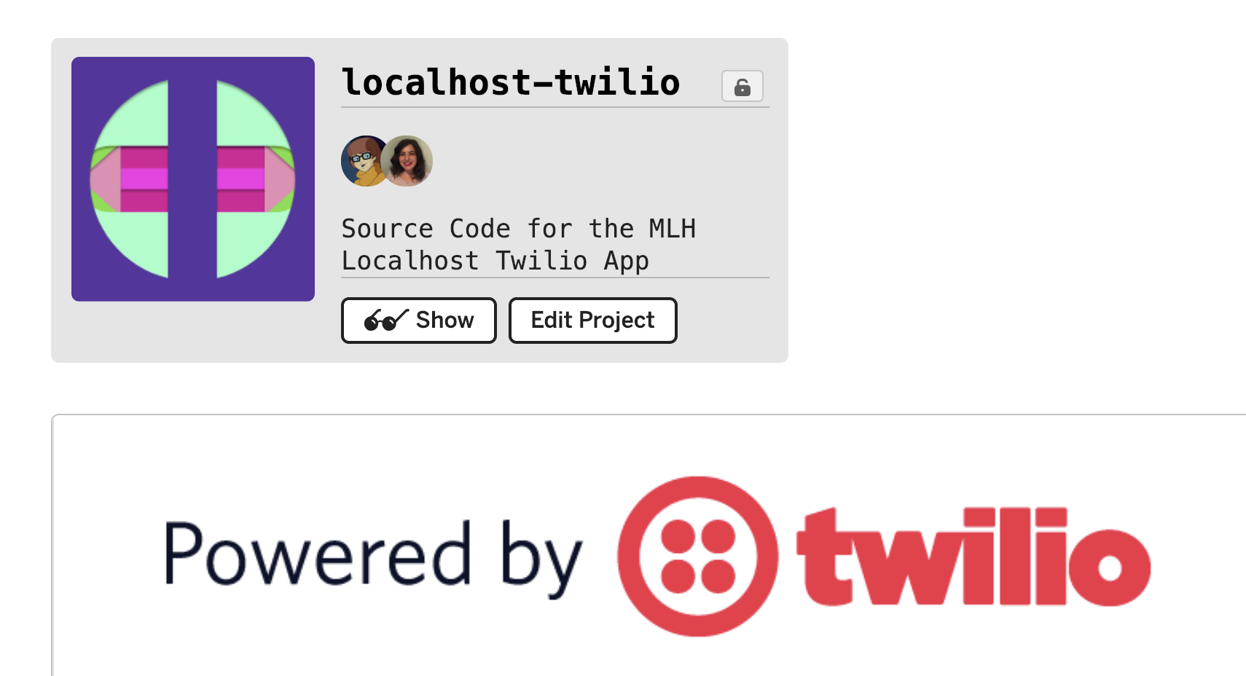
Great, now let’s see the code!
Head to the URL below to see the code on Glitch!
http://mlhlocal.host/twilioapp-code
Notes:
Speaker moves to twilio.com/console

Slide 16
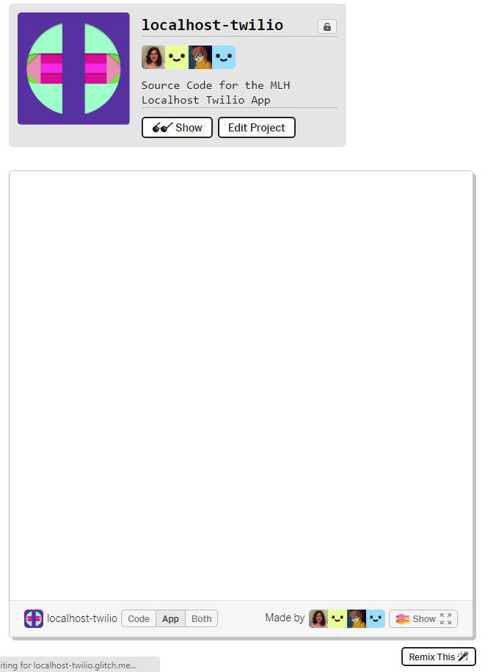
Remix the Project
Click the Remix This button to create a copy of the code.
We’re going to make some edits and get the app running on our own devices.
Notes:
Speaker moves to twilio.com/console

Slide 17
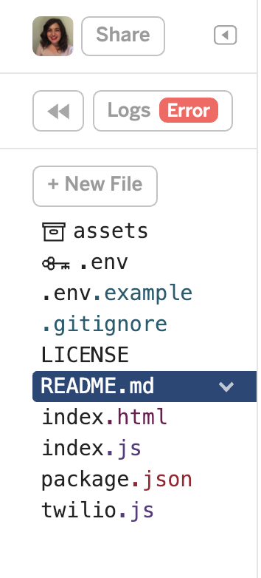
Code Review
The left panel in Glitch shows all the files we have in the project.
We have some Javascript files which communicate with Twilio.
This way, we can send SMS messages to users containing anything we want.
Let’s go under the hood!
Notes:
Speaker moves to twilio.com/console

Slide 18
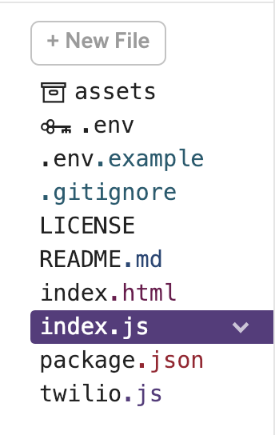

index.js
Select index.js and we’ll take a look at it line by line.
Notes:
Speaker moves to twilio.com/console

Slide 19
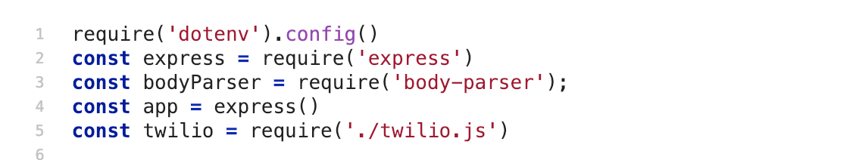
index.js
Lines 1-5: Loads the modules needed by the app. They are listed in the dependencies of the package.json file.
Key Term
Dependencies: When one piece of software relies on another piece to run.
Notes:
Speaker moves to twilio.com/console

Slide 20
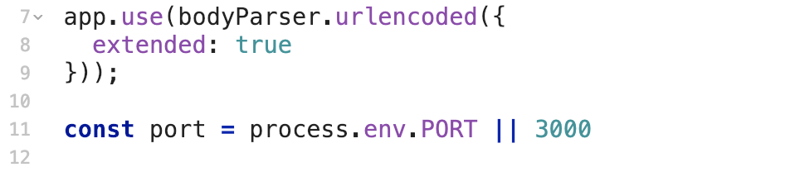
index.js
Lines 7-9: Activates bodyParser, a module that allows us to read SMS messages that users send to Twilio.
Line 14: Sets the network port to either the environment variable PORT or 3000.
Notes:
Speaker moves to twilio.com/console

Slide 21
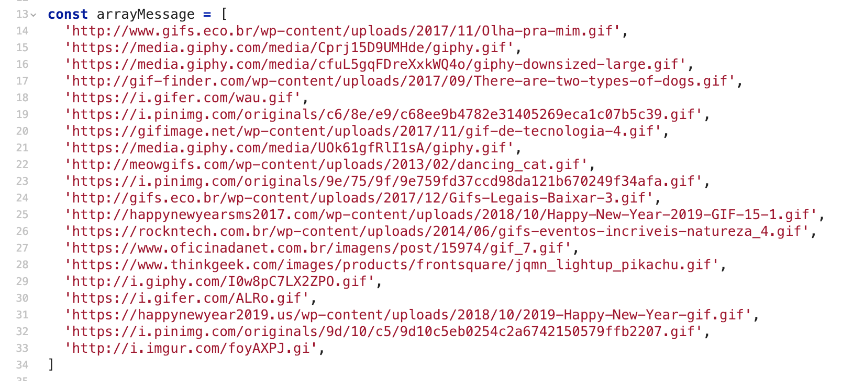
index.js
Lines 13-34 The is the hard-coded list of items that we could send back to the user. Feel free to add your own!
Notes:
Speaker moves to twilio.com/console

Slide 22
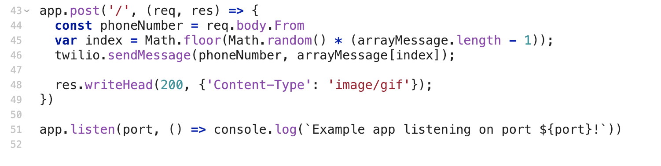
index.js
Line 43: When our app gets a POST request (when someone sends a message to your Twilio number), it does the following:
Line 44: Retrieve the phone number that sent the message
Line 45: generate a random index inside our arrayMessage list
Notes:
Speaker moves to twilio.com/console

Slide 23
index.js
Line 46: Use the Twilio API to send the message back to the phone number
Line 48: sends an ‘ok’ status to our local server to finish.
Line 51: Starts the app running on the user’s network port and prints a message to the console to notify us.
Notes:
Speaker moves to twilio.com/console

Slide 24
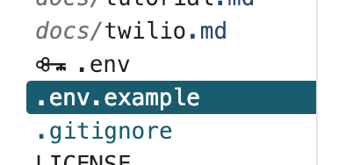
.env.example
Now click on .env.example and let’s look at the environment variables.
Notes:
Speaker moves to twilio.com/console

Slide 25

.env.example
.env.example contains examples of the environment variables our app needs, like API keys.
When we need to use these credentials, we can use the variable name instead of writing the values again and again.
.env.example
Like in twilio.js!
Soon, we’ll be replacing these values with your own credentials.
Notes:
Speaker moves to twilio.com/console

Slide 26
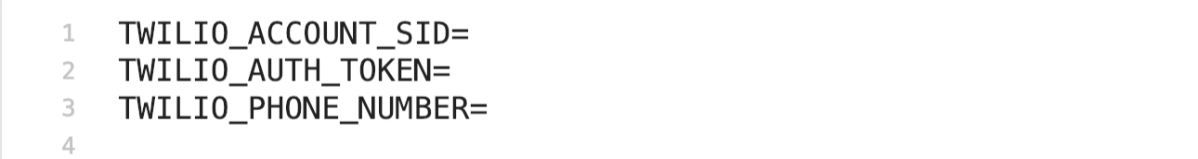
.env.example
Where do we get these variables?
.env.example
These come from Twilio
Notes:
Speaker moves to twilio.com/console

Slide 27
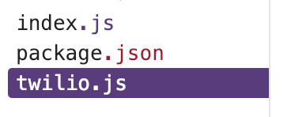
twilio.js
Now click on twilio.js and let’s look at the code!
Notes:
Speaker moves to twilio.com/console

Slide 28
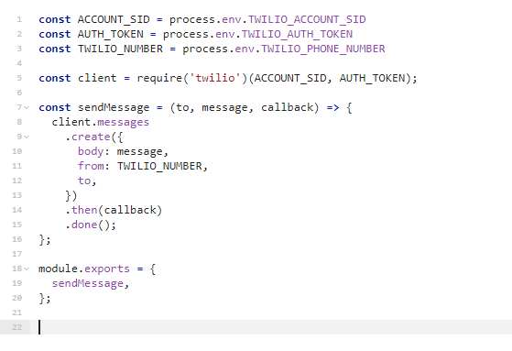
twilio.js
Lines 1-3: Creates the credentials we need to configure Twilio: an SID (security identifier), an authentication token, and our Twilio phone number.
Line 5: Loads the Twilio module and gives it the SID and authentication token.
Notes:
Speaker moves to twilio.com/console

Slide 29
twilio.js
Lines 7-16: Creates a function to craft a new SMS message:
to: A phone number to send it to
message: the content of the SMS
callback: something to do after the message is sent
Notes:
Speaker moves to twilio.com/console

Slide 30
twilio.js
Lines 18-20: This allows the sendMessage function to be used in other files in the app!
Notes:
Speaker moves to twilio.com/console

Slide 31
Now that you are familiar with the code, let's set up Twilio so it can handle the messaging function for us.

Slide 33
Setting up Twilio
Let’s register for Twilio so we can set up our phone number and get the credentials we need to run the app!
Firstly, head to this URL:
mlhlocal.host/twilio

Slide 34
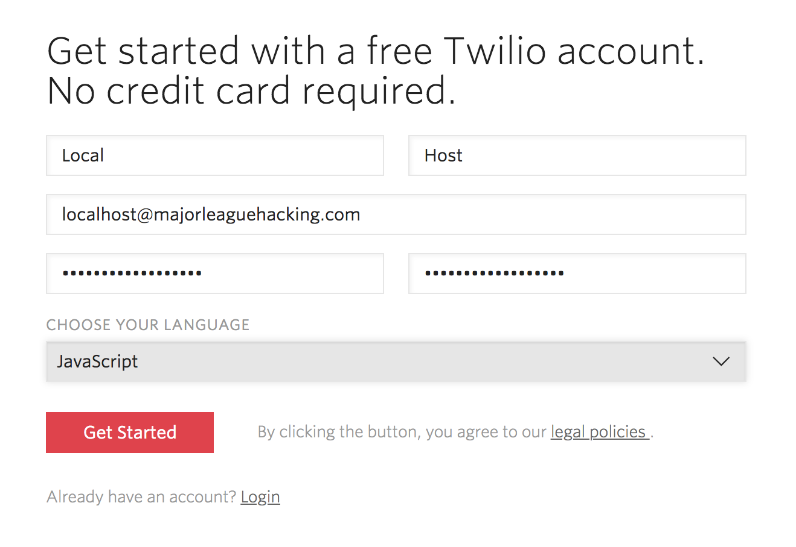
Register for Twilio
Enter your name, email address, and create a password.
Click Get Started.

Slide 35
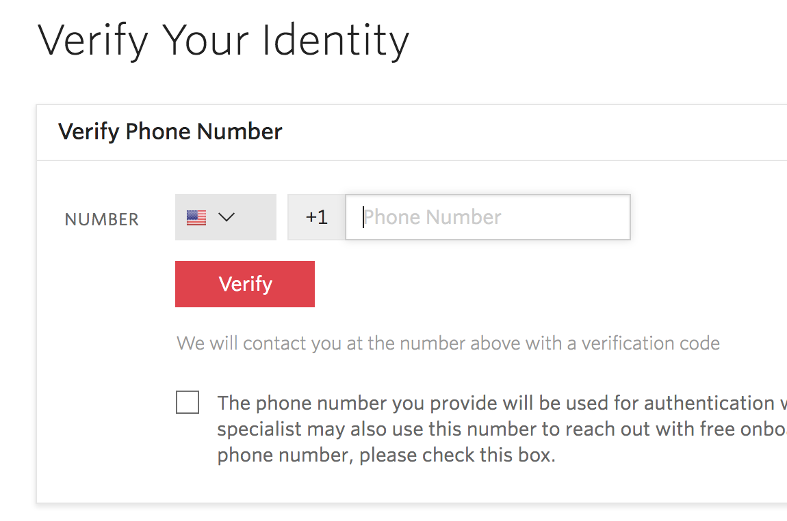
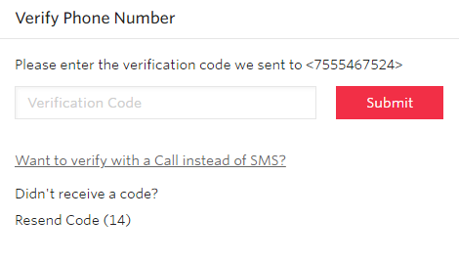
Register for Twilio
Enter your mobile phone number, wait for an SMS, and enter the verification code you receive.
1
2

Slide 36
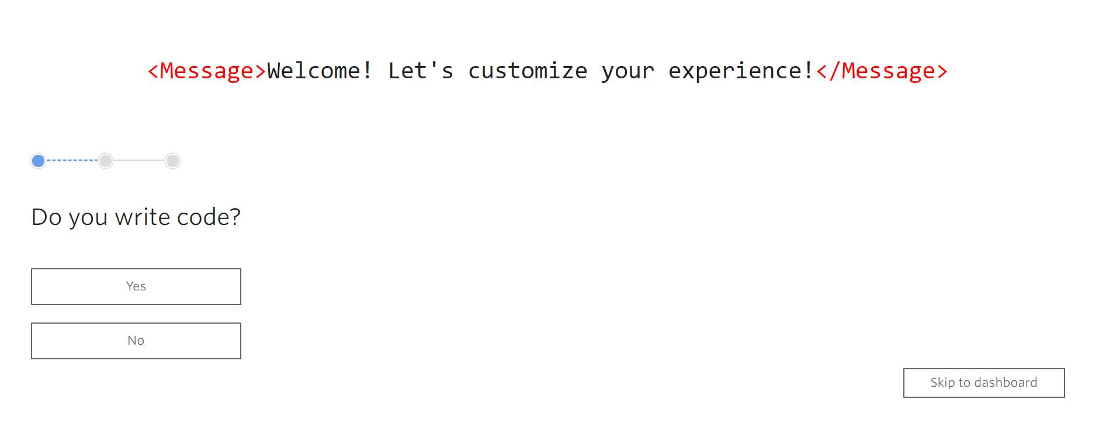
Register for Twilio
You can go ahead and click Skip to dashboard.
3

Slide 37
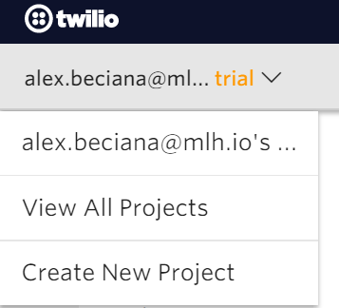
Create a New Project
Click the upside arrow icon next to your email, select Create New Project

Slide 38
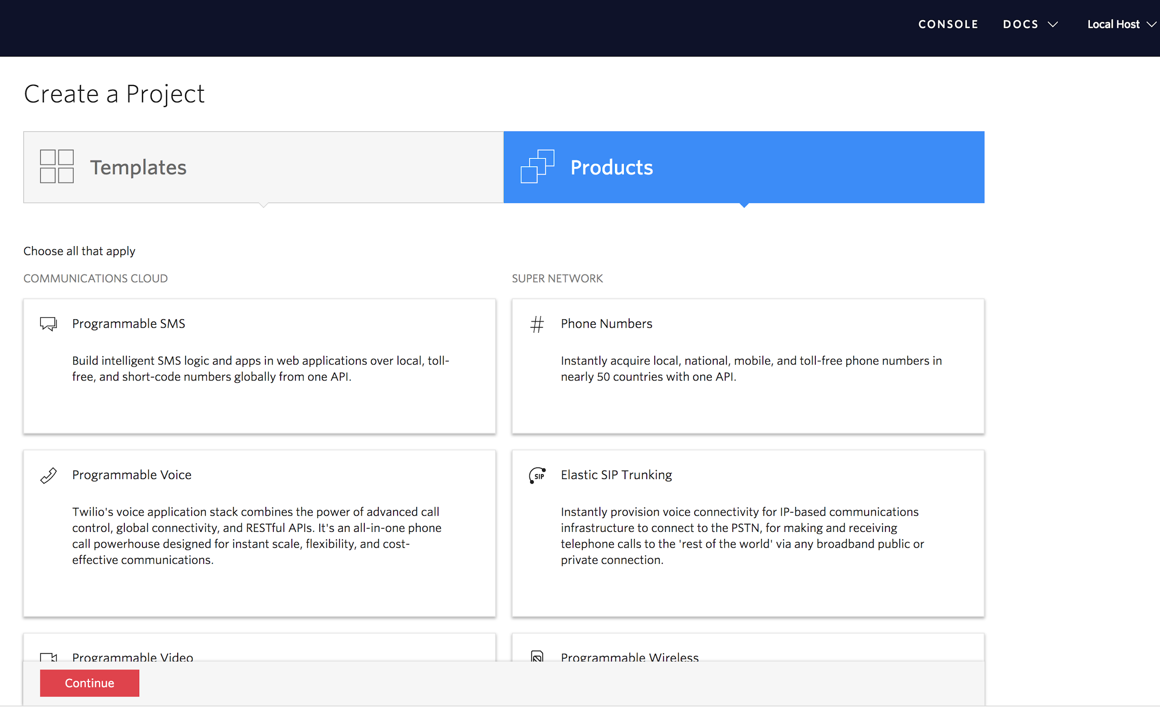
Create a New Project
Click Products, select Programmable SMS, then click Continue.

Slide 39
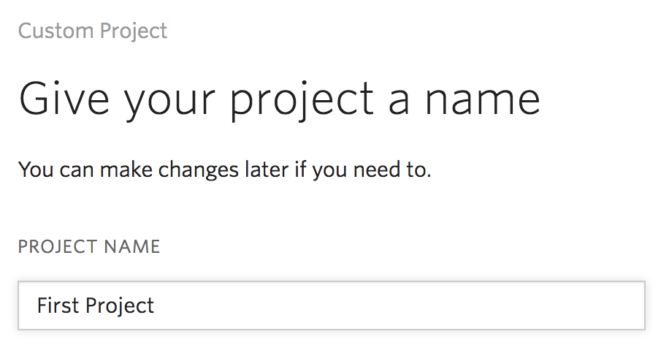
Create a New Project
Type in a name for your project and click Continue.

Slide 40
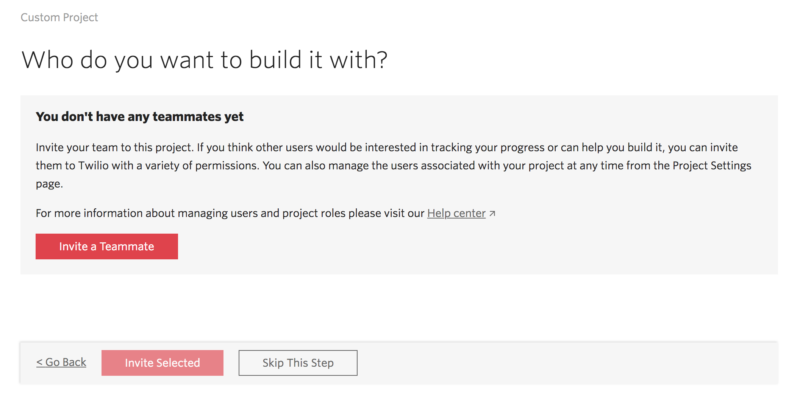
Create a New Project
Select Skip This Step.

Slide 41
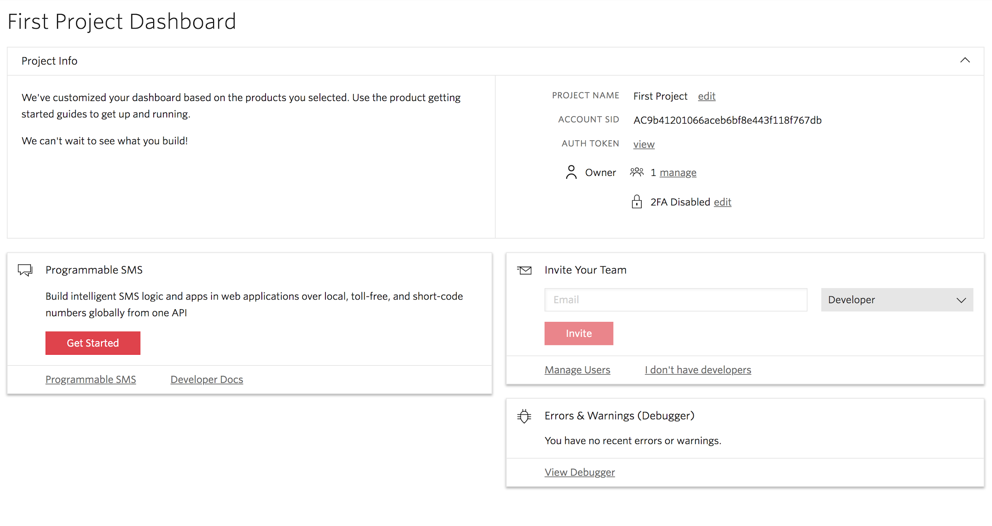
Create a New Project
Click Get Started.

Slide 42
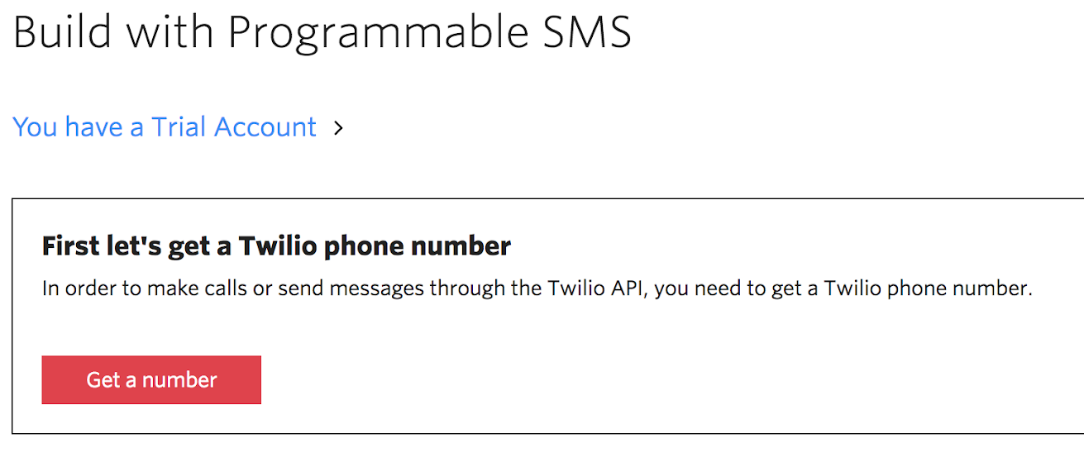
Register a Phone Number
We’re going to register a telephone number to use in our project.
Select Get a number.

Slide 43
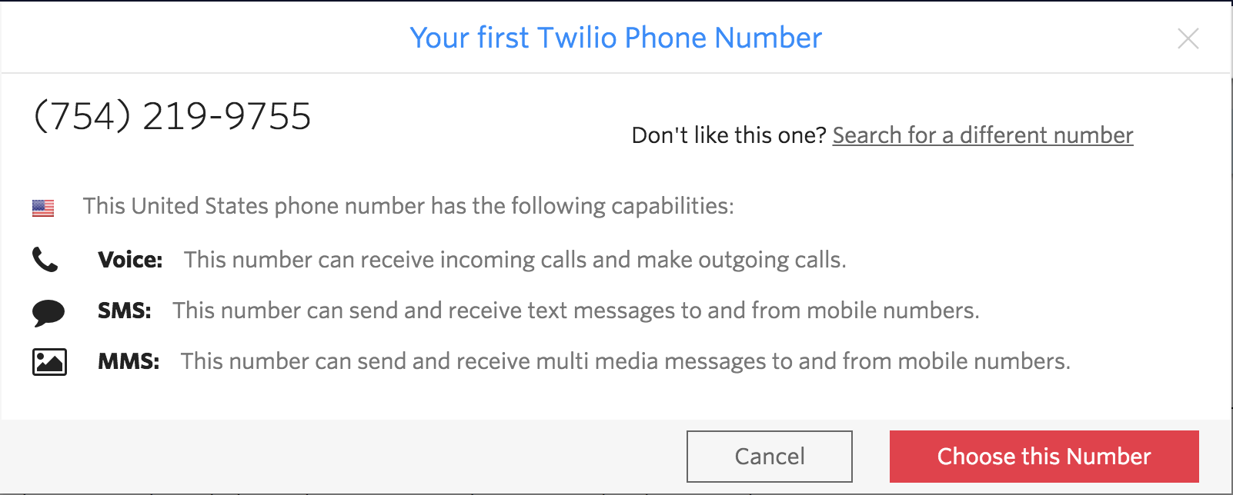
Register a Phone Number
Select Choose this Number. Make a note of your number!

Slide 44
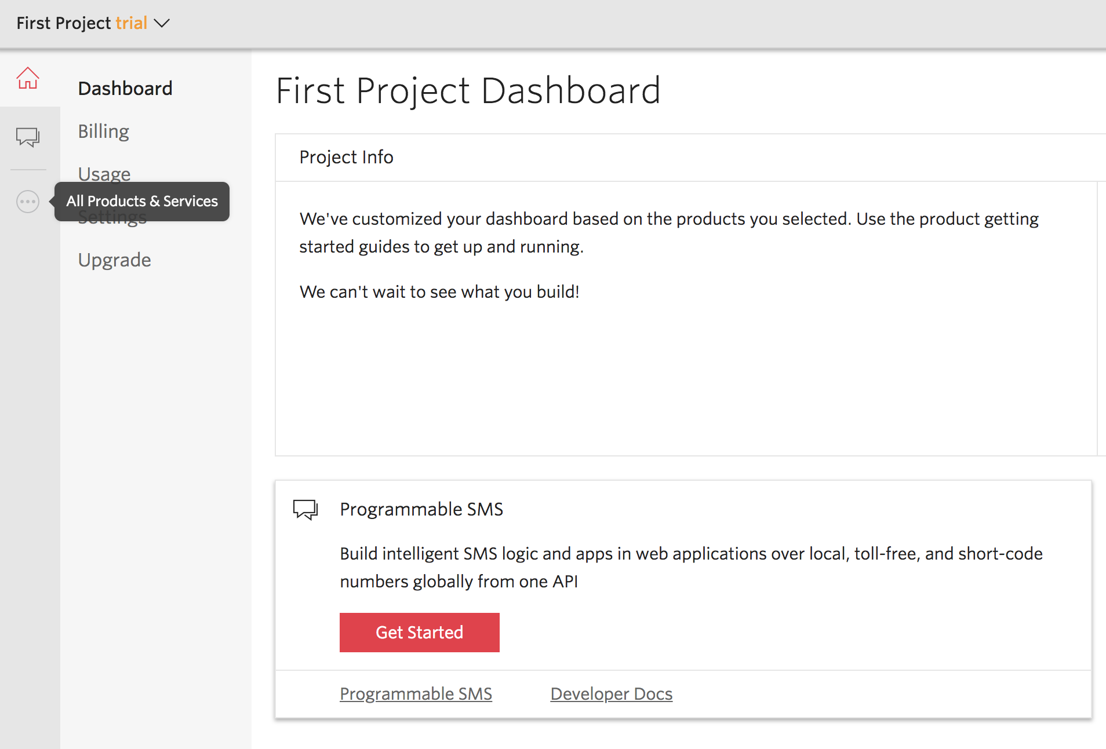
Configure the Phone Number
Click the All Products and Services icon on the left panel (it has three dots).
Notes:
Note - if you’re in the UK (not sure about other countries) you need to put in your address to purchase the phone number - Twilio Info Page

Slide 45
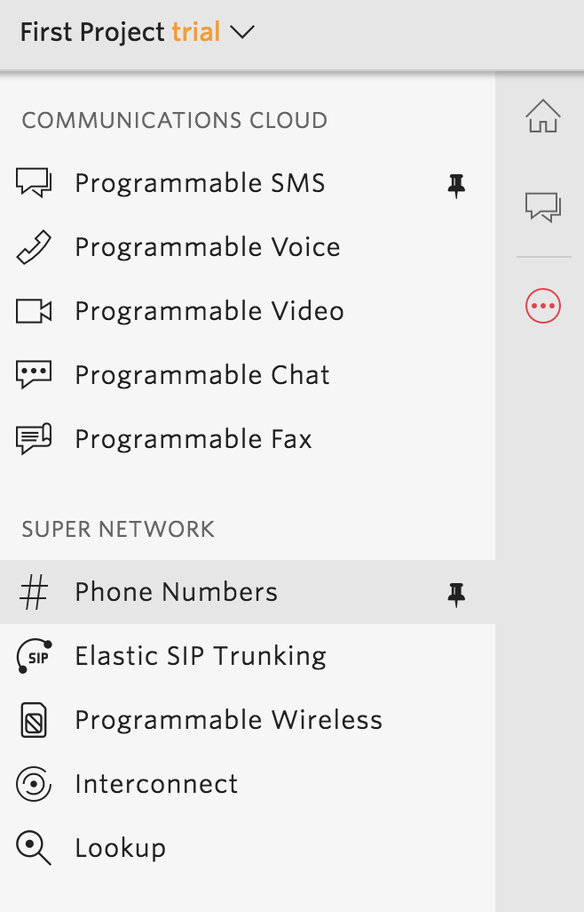
Configure the Phone Number
Then click Phone Numbers.

Slide 46
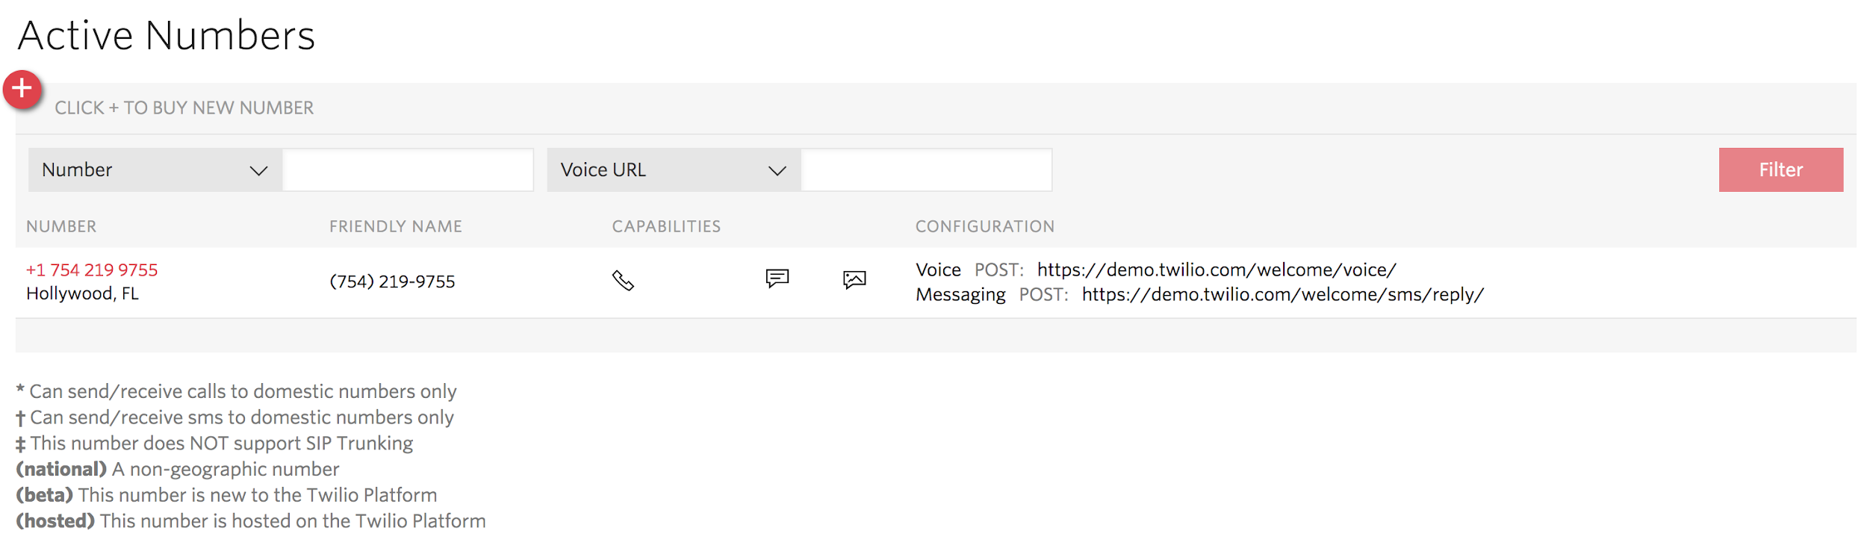
Configure the Phone Number
Click on your new number.

Slide 47
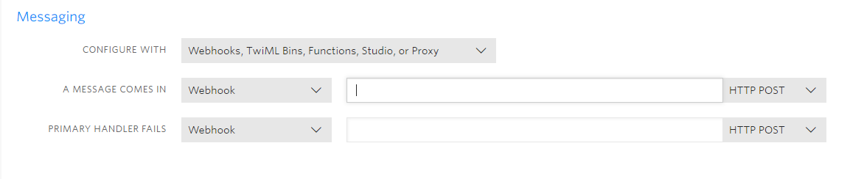
Webhooks
Here is where we configure what happens when someone sends an SMS or a call to your new phone number.
Leave this webpage open for now - we’ll come back to it soon. Now, we’re going to set up the response.

Slide 48
Authentication Tokens
Let’s find our authentication tokens.
Head to the Twilio Console:
http://twilio.com/console

Slide 49
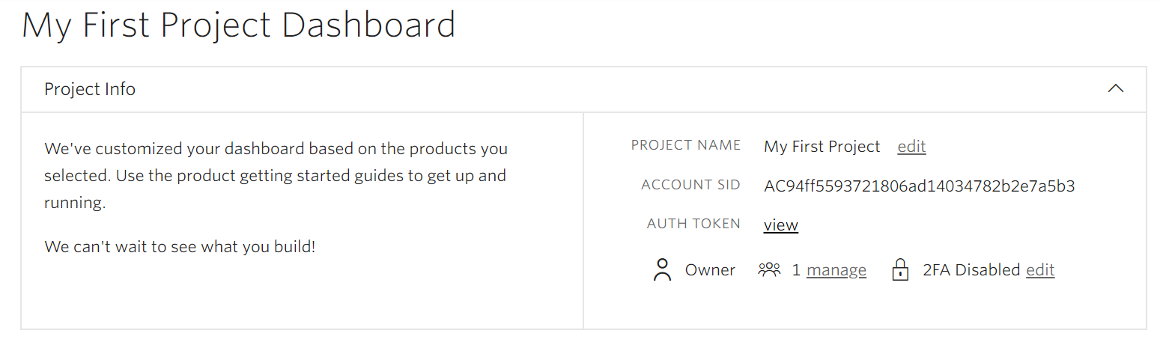
Authentication Tokens
Your Dashboard shows your SID. Click view to see your Auth token too.

Slide 50
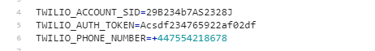
Adding Your Authentication Tokens
Go back to Glitch, open .env (NOT .env.example) and add your phone number and auth tokens.
.env
Your codes will be unique to you!

Slide 51
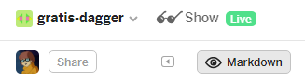
Adding Twilio Webhook
Almost there!
Now all we have to do is launch our app in Glitch, and give Twilio the URL.
Then, when we send an SMS to our number, it will redirect to our app and generate a response.
In Glitch, click Live.

Slide 52
Adding Twilio Webhook
Your app should launch in a new tab. Copy the URL - it will be something like https://random-name.glitch.me.
Head back to your Twilio Phone number dashboard:
https://twilio.com/console/phone-numbers/

Slide 53
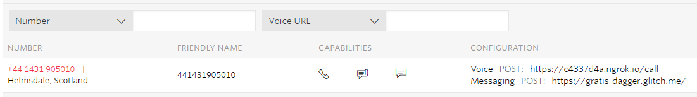
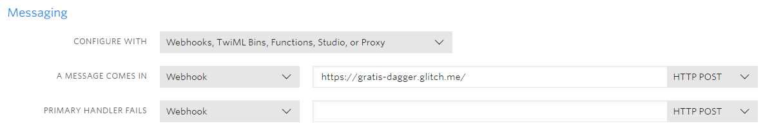
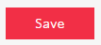
Adding Twilio Webhook
Click on your registered number.
Scroll down to Messaging and add your app url to the Message Webhook. Click Save.

Slide 55
Testing Your App
Trying sending an SMS saying ‘show me a meme!’ to your Twilio number!

Slide 56
Raise your hand and ask for help if your app isn't working!

Slide 58

Let’s recap quickly...
1
Twilio is a PaaS platform which allows you add communication functionality to your projects.
2
The Twilio SMS API allows you to create all sorts of apps that use a texting API.
3
You can use the Twilio console to build the app of your dreams!

Slide 59
What did you learn today?
We created a fun quiz to test your knowledge and see what you learned from this workshop.
http://mlhlocal.host/quiz

Slide 60
Where to go from here...
1
Learn about other Twilio APIs - Voice, Fax, and more!
2
Play TwilioQuest at mlhlocal.host/twilioquest!
3
Complete the additional practice problems. These problems & way more are in your email!

Slide 61
Keep Learning: Practice Problems for Later
Extra Practice Problem 1:
Update the app to ask the participants how many results they want and return that many.
Extra Practice Problem 2:
Update the app to ask participants if they want a GIF or a meme. Then, respond to their request accordingly!

Slide 62

Learning shouldn't stop when the workshop ends...
Check your email for access to:
These workshop slides
Practice problems to keep learning
Deeper dives into key topics
Instructions to join the community
More opportunities from MLH!

Slide 63
v.0.0.1

